Slide 1
CAR Calibration Meeting CAR Review
AP Team
Ronald Tse, Paul Ip, Balina Ling, Simy Li and Adele Fan
June 3, 2014

Slide 2
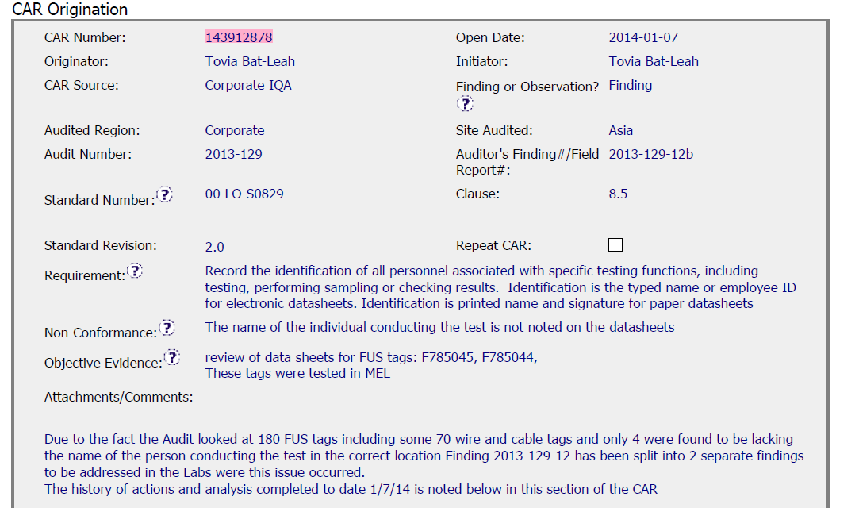
CAR# 143912878 - FINDING CAR
2 FUS Datasheet were found to be lacking the name of the testing staff in the correct location.
Be sure to identify the other CAR and also include it in the CAR reference section of the CAR

Slide 3
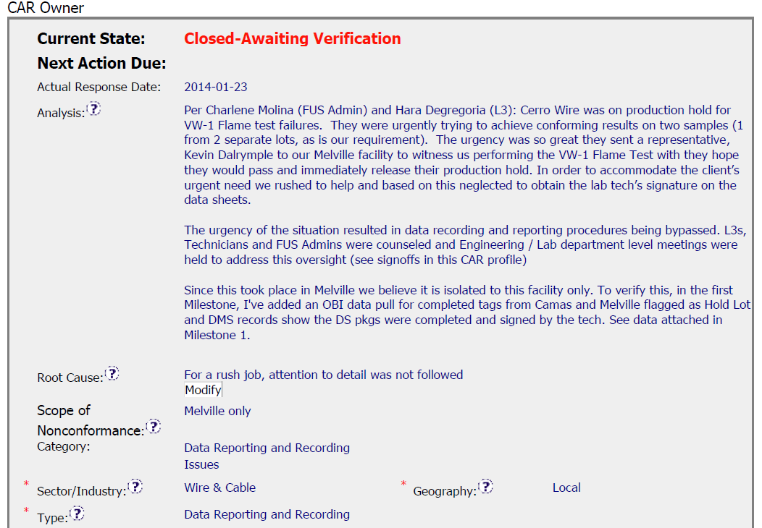
CAR# 143912878
Analysis, Root Cause, Scope and Category are clear and easy to understand.
[COMPETITIVENESS] – (C) Analysis shows clear path to root cause and scope

Slide 4
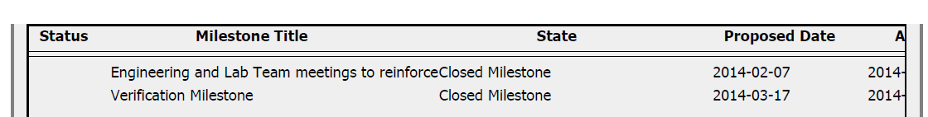
CAR# 143912878
ONLY 2 Milestones to address the scope , BUT history of this CAR was over 6 months due to overdue (waiting response) and change 3 Different CAR Owners/Assistant.
During this period (History List), CAR Champion showed well communication and Teamwork with different CAR Owners, assistant …. FOR EXAMPLE: Concall with CAR Owner to discuss with Root Cause, advise suggestion to Owner.
[Integrity] (T) –Acts on CARs within required timeframe
[Collaboration] (C) – Referenced communications are attached as needed.

Slide 5
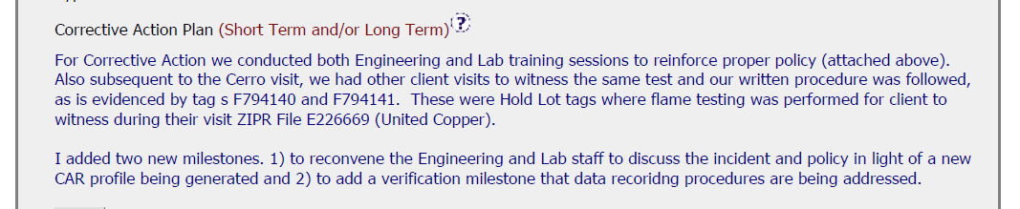
CAR# 143912878
Since it is Finding CAR, containment should be addressed. However, no containment was not provided in this area. We found the reason in History. It may be better to show the reason in this area
[COMPETITIVENESS] – (C) Corrective actions fix the objective evidence and other problems found; address entire root cause and scope.
Document History
[COMPETITIVENESS] – (C) Milestones address containment & owner’s verification; completed per milestone expectations

Slide 6
CAR# 143912878 (Overall Comment)
Good analysis of the finding CAR as further checking on the affected projects in order to determine how widespread of the noncompliance.
Good identification of root cause. Corrective actions are taken based on the root cause identified.
Collaboration between CAR Champions and CAR owner
Notes:
Milestones – have final milestone for owner’s verification of effectiveness; enough time is allowed for new records to be examined
Although CAR owner self-verification is added at the last milestone, it doesn’t cover the corrective action for the failure conducting previous Management Review.
In fact, would the next round of Management Review be able to conducted on-time, it has not been addressed.
It is suggested that the verification should focus on whether the updated process and/or next round of Management Review is in place to avoid recurrence of such nonconformity.
Milestones – completed per milestone expectations
It is acceptable as Containment Action for the supporting evidence covered in the 1st milestone, i.e. Management Review Report for Year 2011 and Year 2012 [Suggest to inviting a person could read German for verification…].
However, the evidence “Attachment of the management review 2013 in milestone one. The effectiveness of the management review was reviewed by the EULA Region Quality Manager and found to be acceptable.” stated in the 2nd milestone is irrelevant while the Management Review for Year 2013 has not been conducted yet. Not sure how CAR Administrator accepts it.
In addition, for 2nd milestone, it is suggested that a statement should be provided by CAR Owner to indicate that “Recommendation for improvement” is now covered as input in the process of Management Review for Year 2011 and 2012...

Slide 7
Review of CAR 143912878

Slide 8
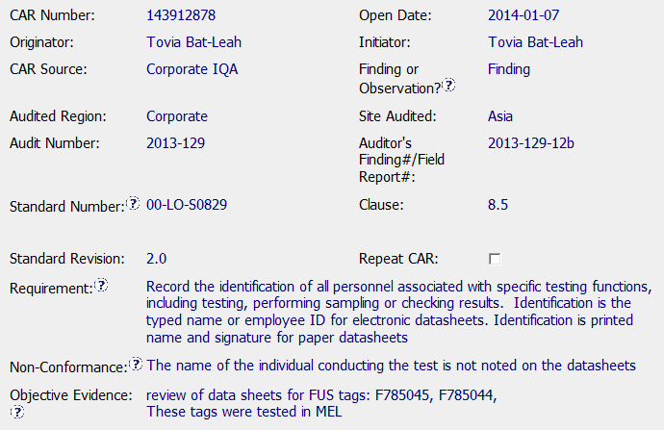
Includes all of the required background info
Is the sample size sufficient?
Info is in LPM

Slide 9
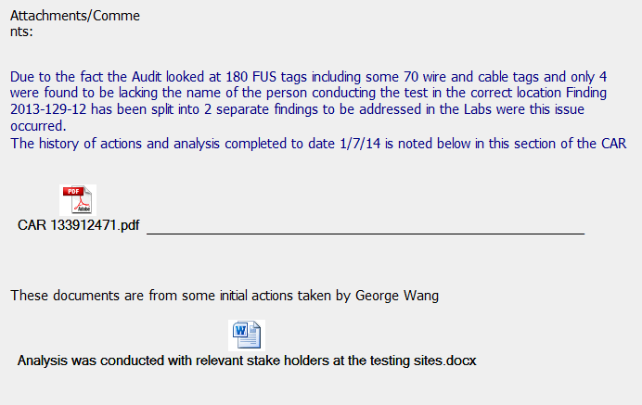
Off the 180 tags selected, 4 were found deficient, amounting to 2.2 %. This clearly confirms that staff for the most part are following the policy. Should this have been a Finding ?
Clearly, a lot of supporting information provided

Slide 10
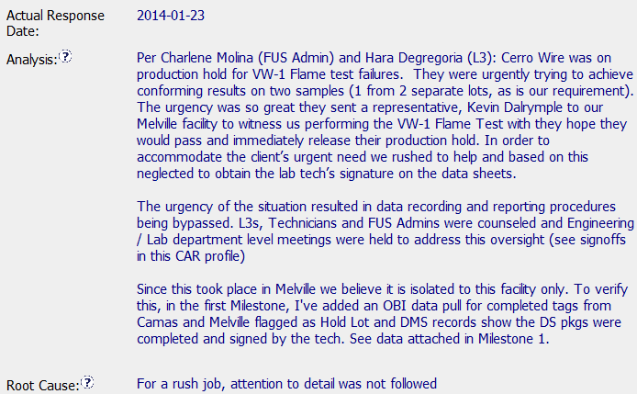
Concise and clear analysis involving stakeholders, reasons, Customer focus.
Actions taken.
Provided data to support analysis.
This could have been worded differently.

Slide 11
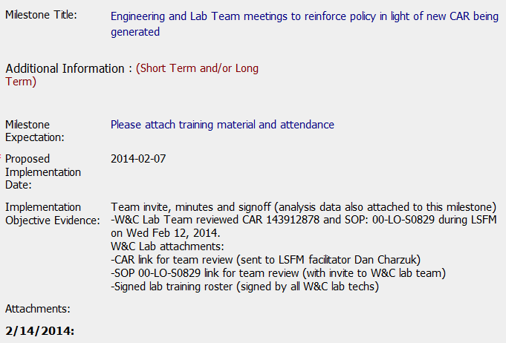
This should be added under the section on “Additional Information” with an aim to limit the title to simple key terms.
Clear statements on Objective Evidence compliance along with necessary supporting documents.

Slide 12
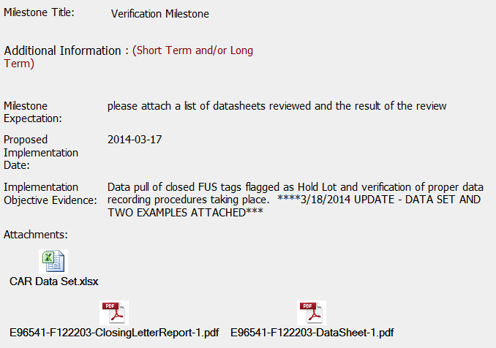
?? … missing what is being verified. How did the CAR Admin know what the CAR Owner was wanting to verify. May be they discussed but not evident.
Clear statements on Objective Evidence compliance along with necessary supporting documents.

Slide 13
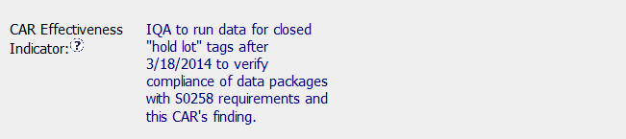
Clear statements on Effectiveness Indicator. Assuming IQA agreed to do the effectiveness verification based on the indicator statement.
Review of CAR History –
CAR issued on Sept 20, 2013
2 Escalations since response not received.
Response received on Dec 1, 2013
Response disapproved on Dec 3, 2013 but an additional extension of 14 days provided
3rd Escalation
Response approved on Jan 27, 2014
Implementation overdue notification - one each for the two milestones

Slide 14
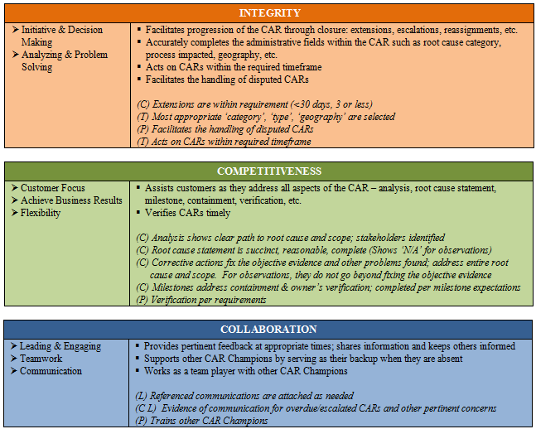

CBS…

